Slide 1


Student Database Management System
Green University Of Bangladesh
Dept. of Computer Science & Engineering
Course Code : CSE 202
Course Title : Object Oriented Programming Lab

Slide 2

Hello!
I am Tarikul Islam
ID : 212002008
Batch : 212
Sec. : DB
Dept. : CSE
Green University Of Bangladesh

Slide 3
Table of Content
Introduction.
Project Demonstration.
Why we need this?
Conclution.

Slide 4

Introduction
Student Database
Management System

Slide 5
Program Concept
Start
1. Add Record
Log In
2. Modify Record
SDMS
3. Delete Record
4. Display
6. Log Out
End program

Slide 6
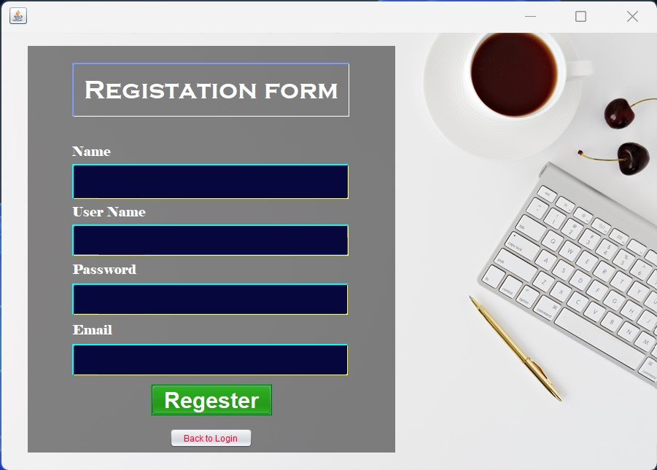
Project Demonstration

Slide 7
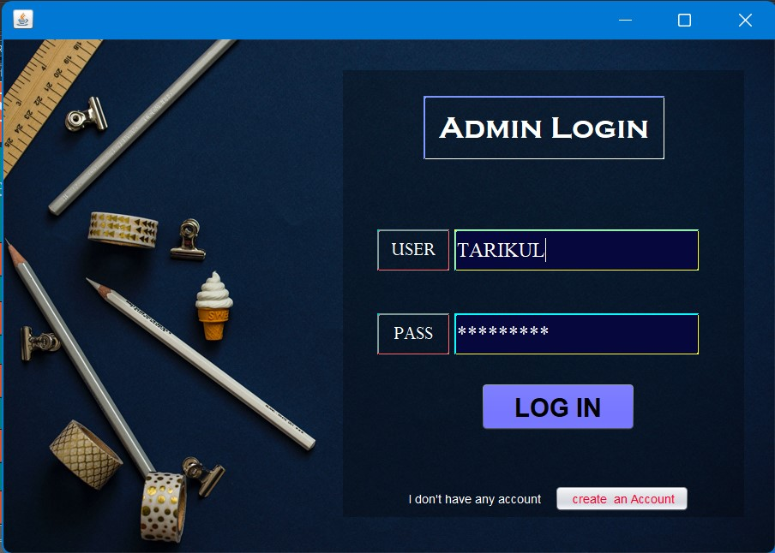
Project Demonstration

Slide 8
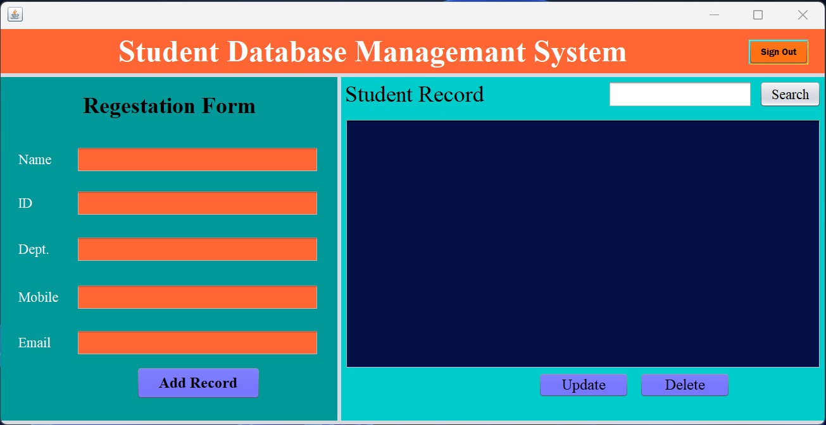
Project Demonstration

Slide 9
Why we need SDMS.
More secure to old manual data record
Reduction of Human Labor and Workload
Easily manage large student databse.
Centralized database to Access from Anywhere
Automatic updates and multiple backups
Helps To Keep Track Of All Students easily

Slide 10
Conclution
This bring to end of my presentation project prgress & shortly breif to my presenting topic…….

Slide 11
Thanks!
Any questions
?

